Slide 1
High Frequency Trading Application
Patrick Flanigan
SWENG 837
Notes:
Hello everyone, my name is Patrick Flanigan a current student of SWENG 837.
Today I'm going to walk you through the design and requirements of a high-frequency trading system.

Slide 2
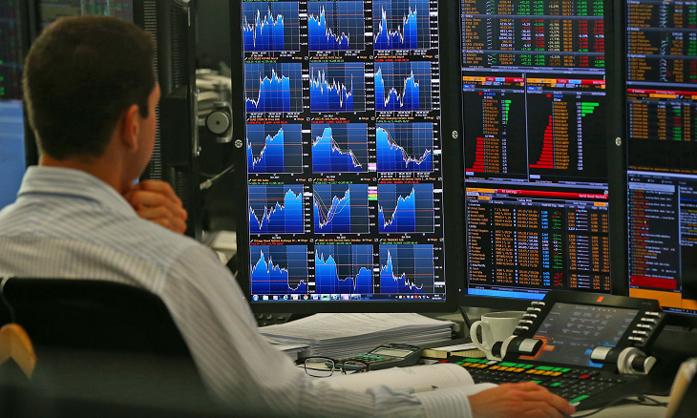
What is high frequency trading?
ProfitView 2024
Notes:
High-Frequency Trading dominates financial markets by driving significant trading volumes, influencing liquidity, price discovery and volatility. While this can enhance market efficiency, it also raises concerns about increased volatility, market fragmentation and regulatory challenges due to risks like market manipulation. These types of applications are advanced software systems that execute large volumes of trades in milliseconds, using algorithms to exploit small market inefficiencies. Traders develop these systems for a competitive advantage, often colocating their platforms near stock exchanges to minimize latency and capitalize on rapid market changes.

Slide 3
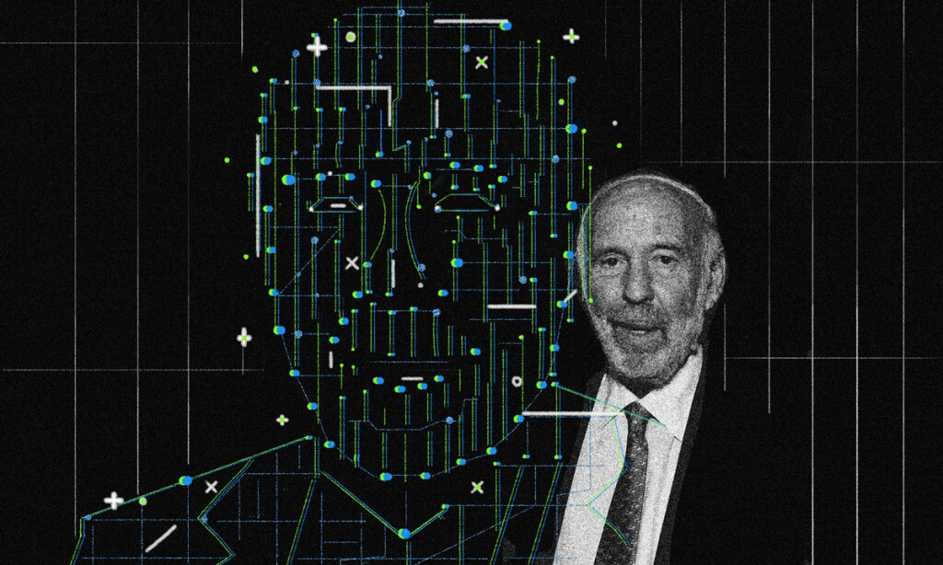
Implemented high frequency trading
ProfitView 2024
Institutional Investor 2024
Notes:
One of the most glaring and successful examples of this type of trading is the Medallion Fund, operated by Renaissance Technologies and founded by Jim Simons, is one of the most successful hedge funds known for its use of sophisticated quantitative models and high-frequency trading strategies.

Slide 4
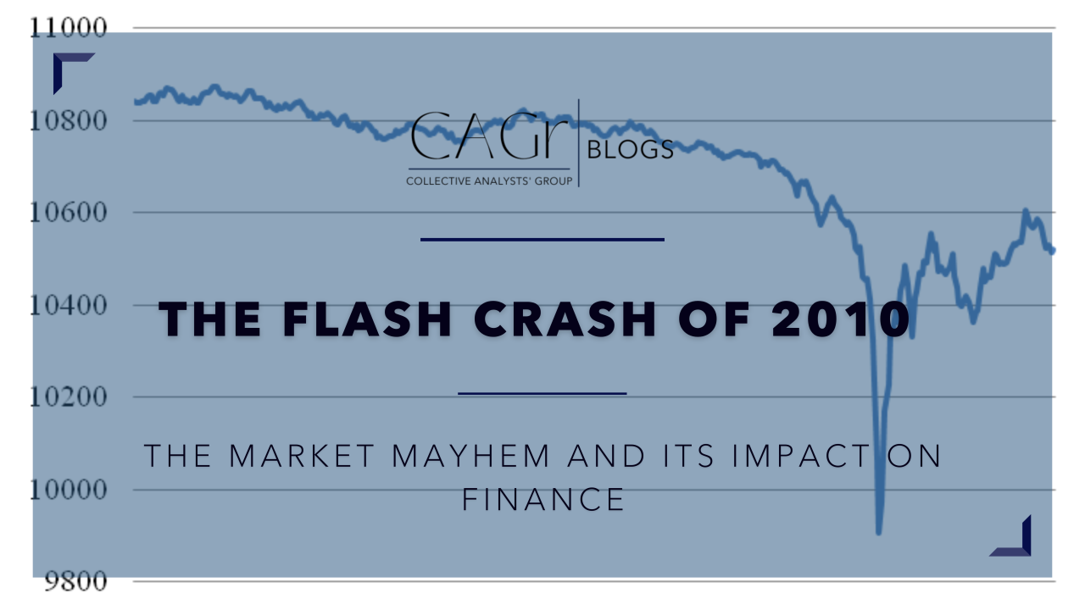
A “flash” crash
LinkedIn 2023
Notes:
Academic studies have shown that this type of trading can cause or exacerbate market crashes by rapidly withdrawing liquidity and amplifying price swings during periods of market stress. For example, the 2010 "Flash Crash" is often cited as a case where this type of trading played a significant role in the sudden, drastic drop in market prices. A study by Kirilenko et al. (2011) titled "The Flash Crash: The Impact of High-Frequency Trading on an Electronic Market" provides detailed insights into how this type of trading can contribute to such market disruptions.

Slide 5
Problem Statement and Requirements
The primary objective of this system is to address the need for high-frequency trading by providing robust platform to train , host and execute trainable market data algorithms for high frequency trading.
Business Requirements:
The system must support rapid order management, seamless market data integration, quick trade execution and advanced portfolio management.
Target Users:
Individual traders who need quick trade execution with access to real-time data.
Institutional traders requiring scalable systems to handle high trade volumes with integrated risk management.
Compliance officers who need to monitor and ensure trading activities comply with regulations.
Business Goals:
Increase trade volume by reducing latency.
Improve decision-making through analytics.
Enhance user satisfaction with reliable performance.

Slide 6
Non-functional Requirements
Performance: The system must be scalable, with millisecond-level response times and the ability to handle high volumes of trades.
Security:
Authentication: Provide for scalable user authentication.
Authorization: Implement role-based access control.
Data Encryption: Ensure data protection, encrypting data both at rest and in transit.

Slide 7
Non-functional Requirements cont’d
Maintainability:
Database Normalization: Optimize database structure for efficiency and scalability.
Modularization: Ensure clear separation of concerns within the system.
Non-Overlapping Functions: Design with distinct, non-redundant components.

Slide 8
Non-functional Requirements cont’d
Other Considerations:
Compliance: Leverage technologies for adherence to financial regulations.
High Availability: Ensure redundancy and failover.
Reliability: Utilize auto scaling and load balancing for consistent performance.
Usability: Optimize user experience via services tailored to reduce latency.

Slide 9
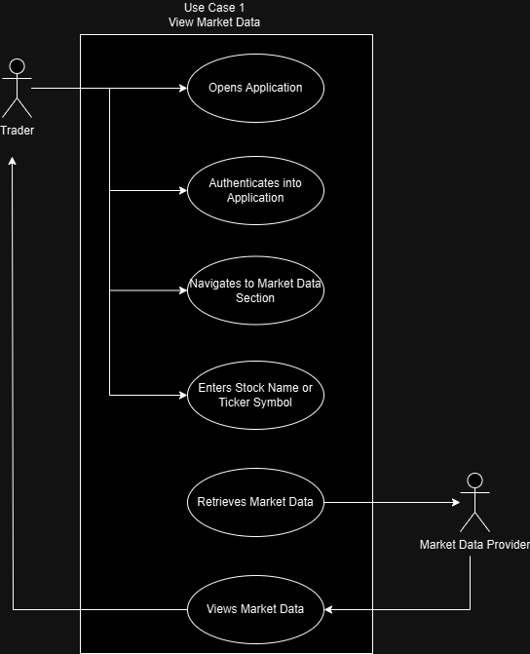
Use Case Diagram
Notes:
The Use Case Diagram highlights the key actors, including traders, market data providers and clearinghouses, who interact with the system. Traders perform actions like placing orders, viewing market data and executing trades. The system interfaces with external market data providers to retrieve real-time information.

Slide 10
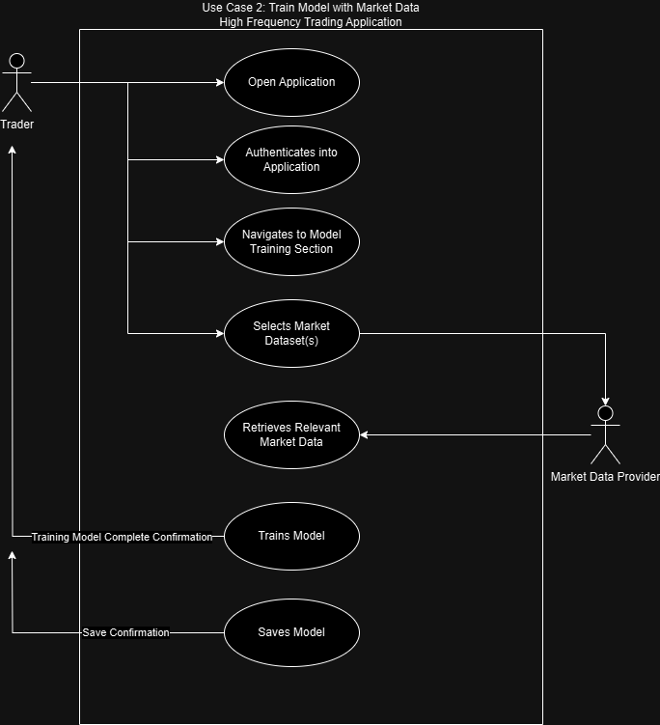
Use Case Diagram cont’d

Slide 11
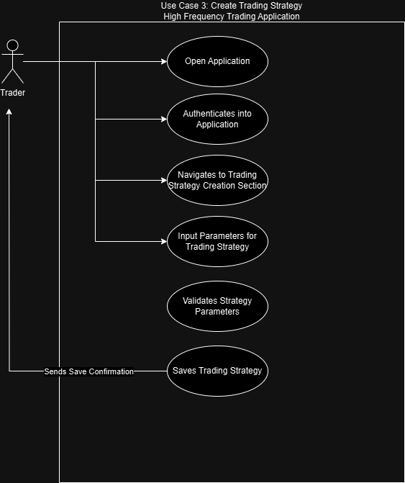
Use Case Diagram cont’d

Slide 12
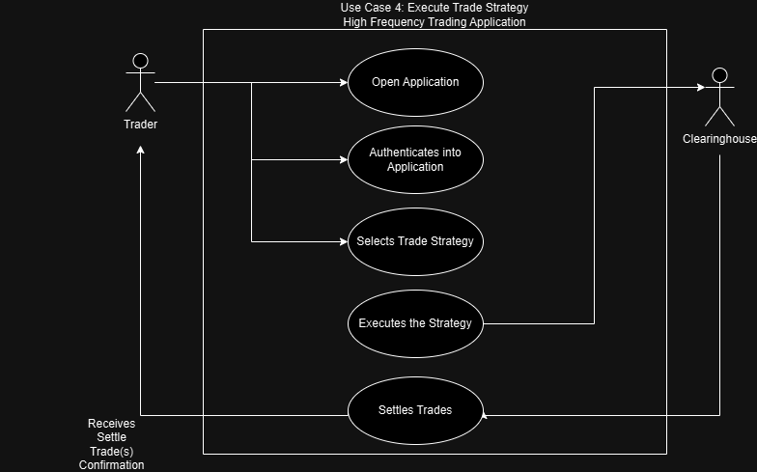
Use Case Diagram cont’d

Slide 13
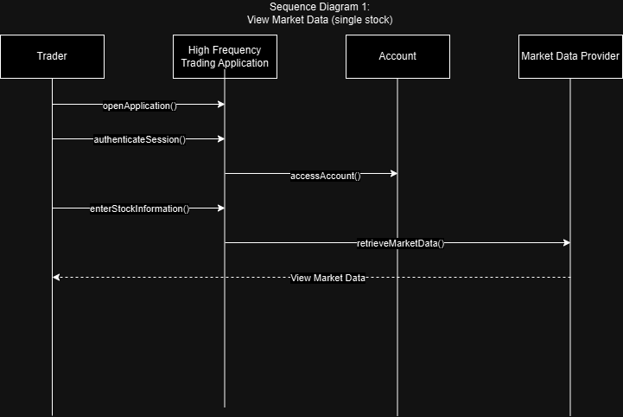
Sequence Diagram
Notes:
The Sequence Diagram illustrates the flow of activities in a typical trading scenario. It shows the interactions between a Trader and the system, such as logging in, retrieving market data, placing an order and receiving confirmation of the trade execution.

Slide 14
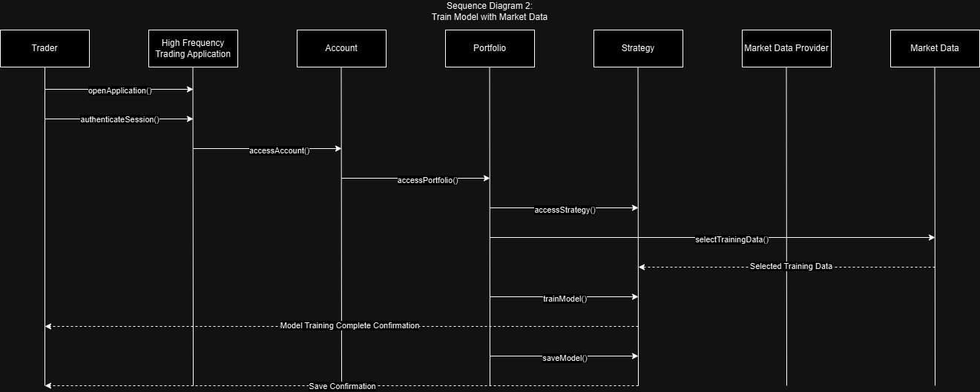
Sequence Diagram cont’d

Slide 15
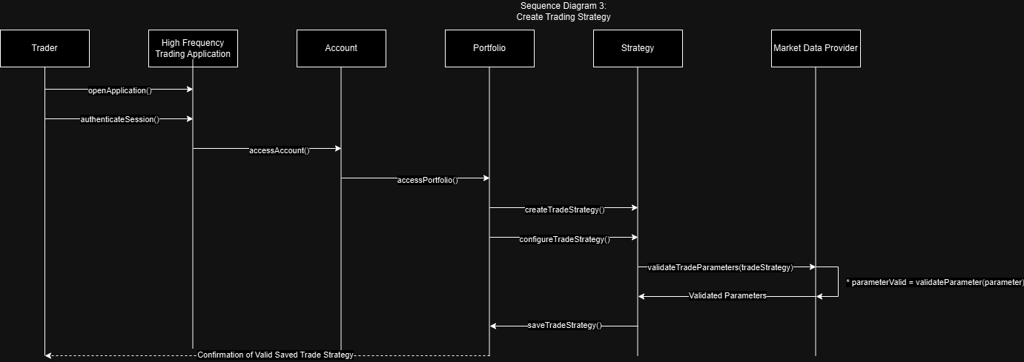
Sequence Diagram cont’d

Slide 16
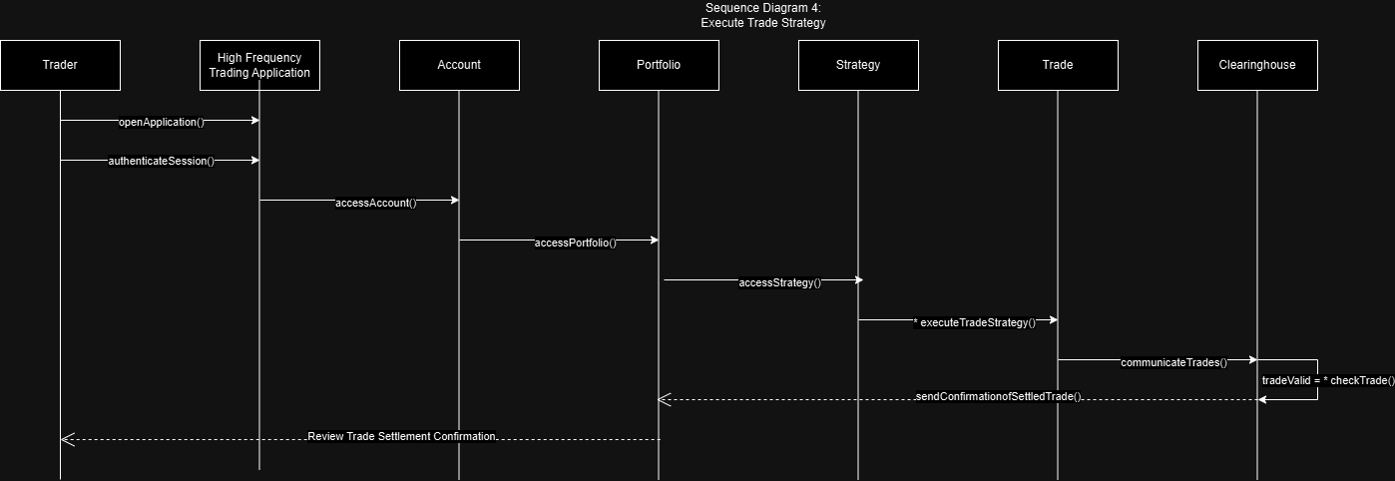
Sequence Diagram cont’d

Slide 17
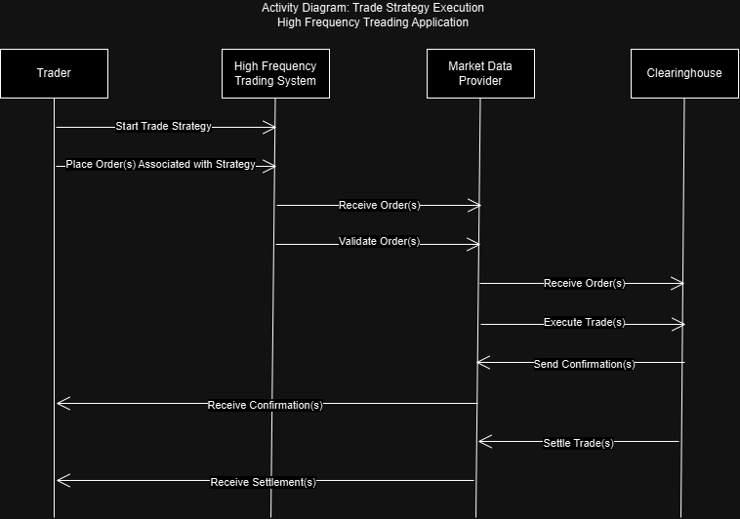
Activity Diagram
Notes:
Activity Diagram further details the interactions between the Trader, High-Frequency Trading System, Market Data Provider and Clearinghouse, highlighting the process of order placement, validation, execution and settlement in high-frequency trading applications.

Slide 18
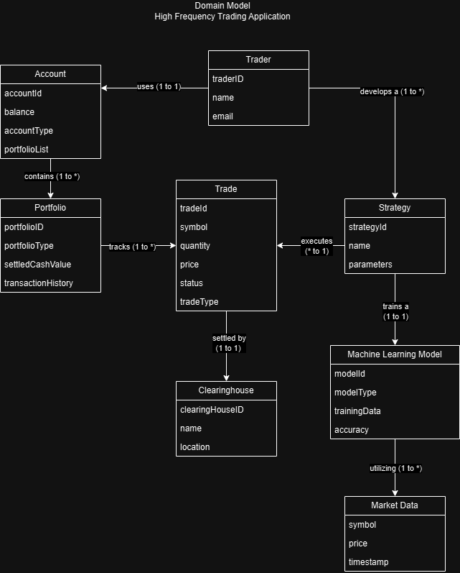
Domain Model
Notes:
The Domain Model for the High-Frequency Trading Application outlines the key entities such as Trader, Account, Portfolio, Trade, Clearinghouse, Strategy, Machine Learning Model and Market Data and their relationships. Traders manage accounts and portfolios, develop strategies and execute trades, which are settled by Clearinghouses. Strategies may be enhanced by Machine Learning Models trained on Market Data to optimize trading decisions. This model emphasizes the structured interactions and dependencies essential for efficient high-frequency trading operations.

Slide 19
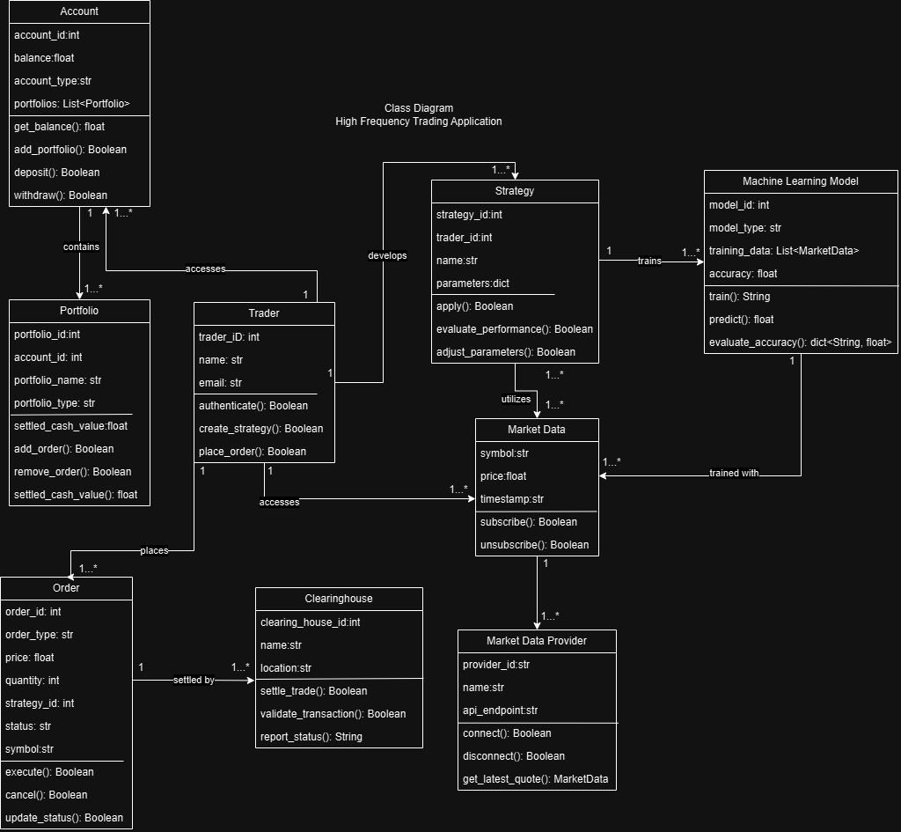
Class Diagram
Notes:
The Class Diagram details the key classes in the system, such as Trader, Order, Portfolio and MarketData. Each class contains attributes relevant to its role, like the Trader class with email and name and the Order class with order type and status. Relationships between classes, such as the association between a Trader and their Portfolio or Orders, are also depicted, reflecting the system's structure.

Slide 20
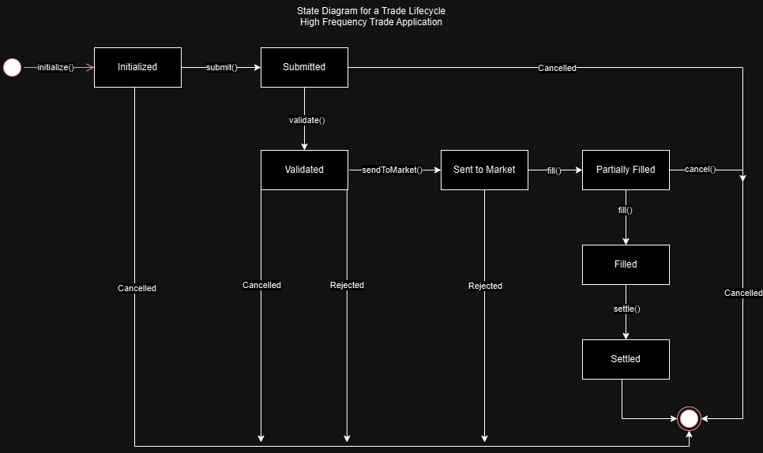
State Chart
Notes:
The State Chart Diagram explains the state transitions of critical objects, such as an Order. An Order might transition through states like "Pending," "Executed“ and "Cancelled" with specific actions triggered by these transitions, such as notifying the Trader or updating the Portfolio's value.

Slide 21
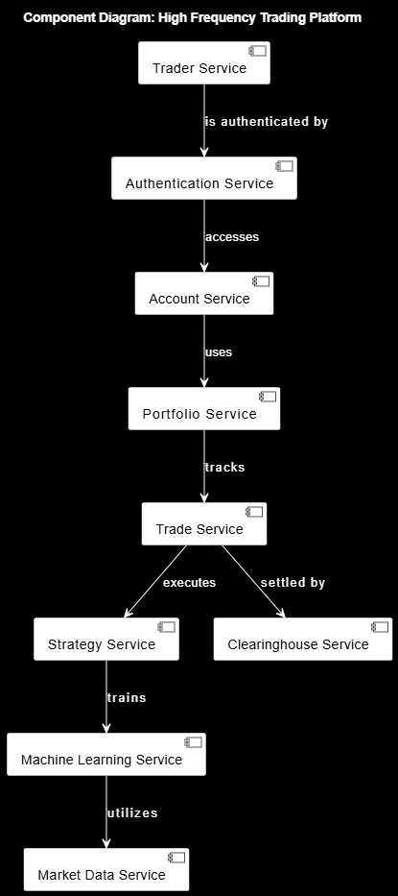
Component Diagram
Notes:
The Component Diagram describes the system's modular structure, showing how different component interact and depend on one another. It provides a high-level view of the system's architecture, illustrating how these components are deployed within the overall framework.

Slide 22
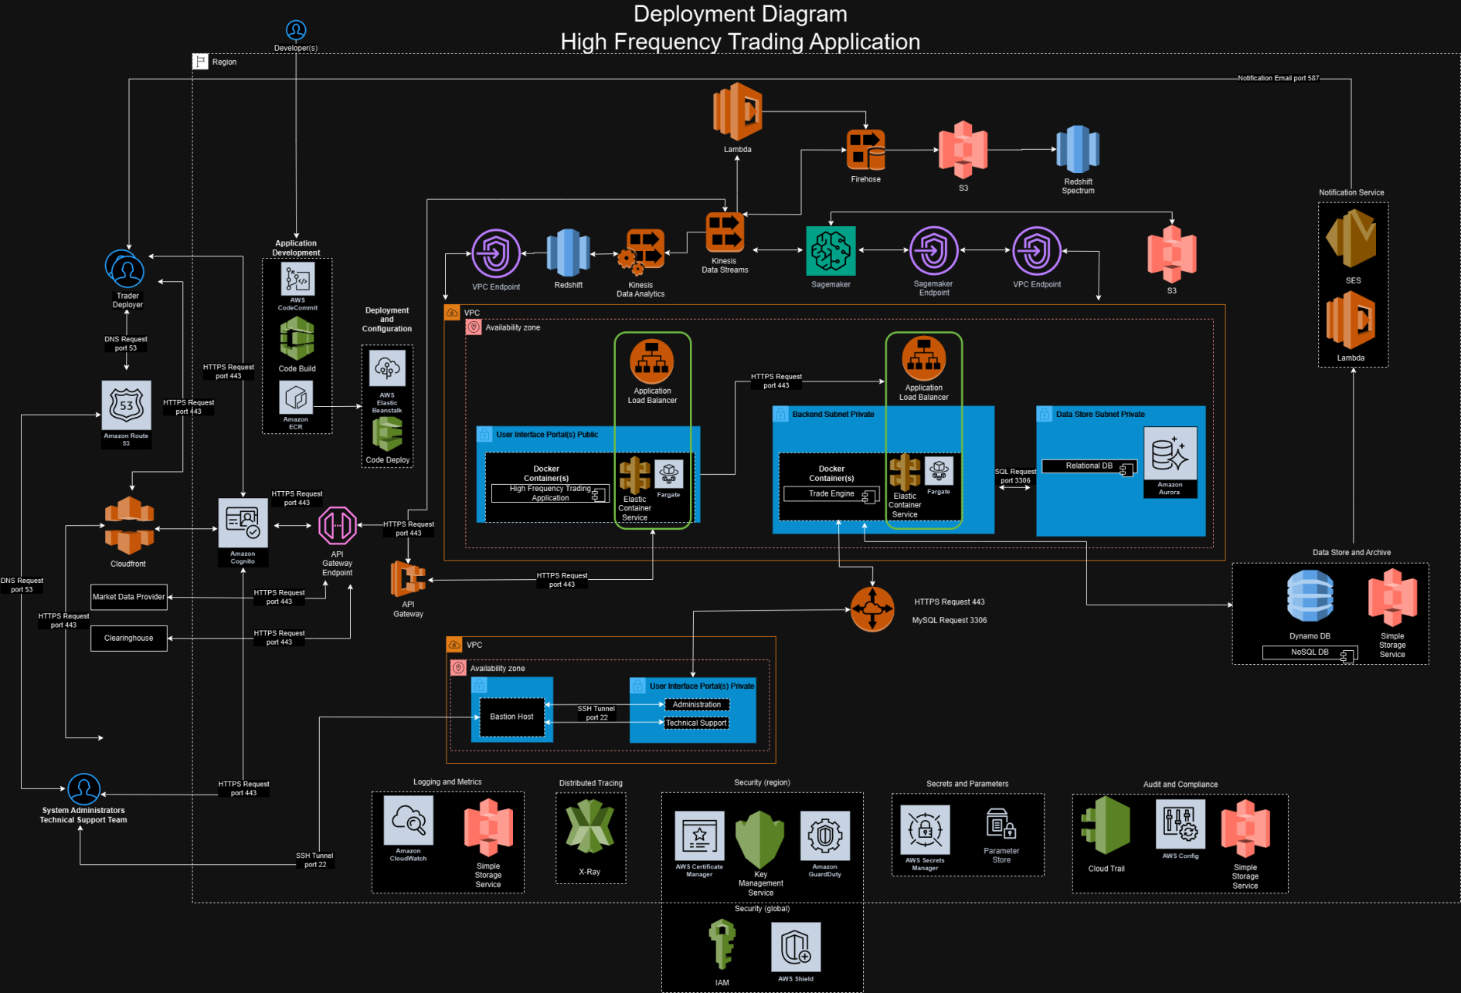
Architecture Pattern
Notes:
The system adopts a Microservices architecture, where each core function, such as order management, is handled by an independent service. This approach allows for independent development, scaling and deployment of each component, ensuring the system is both scalable and resilient. The choice of Microservices is justified by the need for high availability, flexibility in scaling specific parts of the system and ease of maintenance.
For reference to quickly summarize:
User Interface & Interaction
User/Deployer Access: Secure trader system access and interaction.
Technical Support: Secured maintenance and monitoring.
Trading Application Backend
Trading Engine: Core trading logic execution.
Market Data Processing: Real-time market data analysis.
Trade Execution: Secure trade execution system.
Data Management & Storage
Data Storage: Persistent data storage management.
Relational Data: Secure relational database access.
Security & Compliance
Security Management: Comprehensive security and protection.
Audit & Compliance: Compliance and audit logging.
Application Development & Deployment
CI/CD: Automated deployment and integration.
API Gateway: Secure API communication management.
Monitoring & Logging
Logging & Metrics: Continuous monitoring and logging.
Notification Services: Automated notifications and alerts.

Slide 23
Design Principles
GRASP
SOLID
GOF
Microservices
Database Normalization
YAGNI and KISS
Notes:
GRASP Patterns:
Such as Information Expert and Creator, ensure responsibilities are well-distributed across the system.
SOLID Principles:
Ensure that the system is modular, extensible and easy to maintain, with clear responsibilities assigned to each class.
GOF Design Patterns:
Patterns like Strategy and Observer are used to handle dynamic trading strategies and real-time market data updates.
Microservices Design Patterns:
The system is decomposed into microservices like Trader Service, Order Service and Market Data Service, each responsible for specific aspects of the trading platform.
Database Normalization:
Ensures efficiency, consistency and integrity of the database, adhering to the first three normal forms and applying the DRY principle.
YAGNI and KISS Principles:
These are applied to avoid overengineering and ensure the system remains simple and focused on current requirements.

Slide 24
Conclusion and Next Steps
Key Takeaways:
More organized “design” approach aside from xtreme programming techniques.
Not “building” the ship during the storm.
Project Benefits:
Literature and thorough examples of progressive design just before development and implementation.
More detailed information available via pdf.
Notes:
In conclusion, this high-frequency trading system is designed with a comprehensive understanding of the needs of various stakeholders in the trading environment. The architecture is robust, scalable and adheres to best practices in software design, ensuring it can handle the demands of real-time trading while being flexible enough to evolve as market needs change.
No longer have to “build” the boat during the storm. Now have a foundational knowledge and backing literature for progressive design and modelling.
More detailed information on report pdf.

Slide 25
Github Page
Hosted content page
https://github.com/vampireLibrarianMonk/837_hft

Slide 26
Works Cited
Ambler, Scott W. "Data Normalization: Beyond 3rd Normal Form (3NF)." Agile Data, www.agiledata.org/essays/dataNormalization.html#1NF. Accessed 10 Aug. 2024.
Arora, Saiyam. "The Flash Crash of 2010: Market Mayhemand Its Impact." LinkedIn, 22 Sept. 2023, www.linkedin.com/pulse/flash-crash-2010-market-mayhem-its-impact/. Accessed 10 Aug. 2024.
Calvello, Angelo. "The Medallion Fund, Skepticism and a Failure to Comprehend." Institutional Investor, 4 Mar. 2020, www.institutionalinvestor.com/article/2bsx55uaovbhxkya57h8g/opinion/the-medallion-fund-skepticism-and-a-failure-to-comprehend/. Accessed 10 Aug. 2024.
KIRILENKO andREI, et al. “The Flash Crash: High-Frequency Trading in an Electronic Market.” The Journal of Finance, vol. 72, no. 3, 2017, pp. 967–98. JSTOR, http://www.jstor.org/stable/26652722. Accessed 10 Aug. 2024.
"The Concept of Concepts: HFT." ProfitView, 12 Sept. 2021, profitview.net/blog/the-concept-of-concepts-hft. Accessed 10 Aug. 2024.

